Slide 1
PHP & MySQL
Introduction to Server Side Scripting with Databases
Notes:
1

Slide 2
Agenda
PHP Review
Server-side Forms Processing
Interacting with a Database
Using AJAX to interact with a Database

Slide 3
PHP Review

Slide 4
PHP Syntax 1 of 2
<?php
echo 'This is a PHP block';
echo 'Hello world!';
?>
echo is commonly used to write output in PHP

Slide 5
PHP Syntax 2 of 2
<?php
echo '<h2>We can write out HTML too...</h2>';
$sum = 2 + 4;
echo 'As well as variables. The sum is: ' . $sum;
echo "Double quoted strings are parsed: $sum \n"; echo 'Single quoted strings are not.';
?>
The period "." is the concatenation operator in PHP.

Slide 6
PHP Comments
<?php
// comments are just like those in JavaScript
/*
even those that span
multiple lines
*/
?>

Slide 7
PHP Variables
Variables in PHP are declared using a "$" sign
Variables in PHP, like in JavaScript, are loosely typed
<?php
$i = 0;
$name = 'Simon';
?>

Slide 8
PHP Statements
if (true) { echo 'This will be written'; }
for ($i=0; $i < 10; $i++) { echo $i . '<br/>'; }

Slide 9
Arrays
Numerically indexed arrays in PHP are very similar to those we've seen in JavaScript: $myArray = array( 'lions', 'tigers', 'bears'); // will output lions: echo $myArray[0]; // will output the whole array: for ($i = 0; $i < count($myArray); $i++) { echo $myArray[$i] . '<br/>'; }

Slide 10
Associative Arrays
An associative array is a data type that represents key = value pairs (like a "map" or "hashmap" in other languages) $inventory = array( 'doohickeys' => 200, 'gizmos' => 5 ); // will output 200: echo $inventory['doohickeys']; // will output all key/value pairs in the array: foreach ($inventory as $key => $value) { echo $key . ' - ' . $value . '<br/>'; }

Slide 11
$_POST Example
In index.php: <form action="greet.php" method="post"> Name: <input type="text" name="name" value=""/> </form>
In greet.php: <p>Hello <?php echo $_POST["name"]; ?>.</p>

Slide 12
print_r() and var_dump()
excellent helper functions used to investigate variables and objects
displays the information in a human-readable format; can be very helpful during development
See:
http://php.net/manual/en/function.print-r.php
http://www.php.net/manual/en/function.var-dump.php

Slide 13
<code> Simple PHP Form Example
Download itws-php.zip and unzip it in xampp/htdocs/iit/
You will have two folders extracted:
iitforms
iitajax
Open iitforms/index.php in sublime (or your editor of choice)
Open http://localhost/iit/iitforms/ in your browser
Let's examine the code.

Slide 14
Example Web Application Architectures

Slide 15
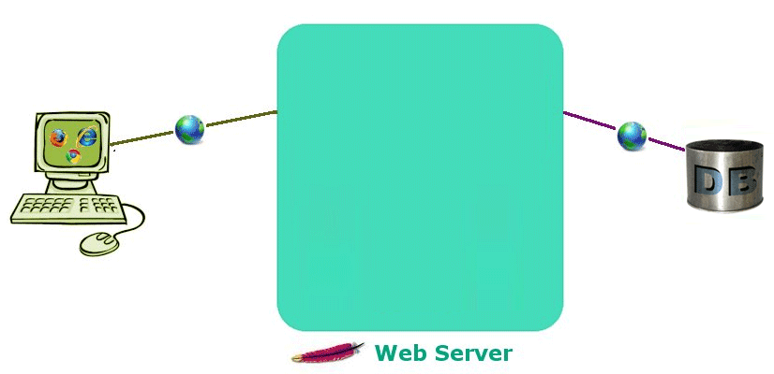

Web Application Architecture Simple Example

Slide 16
Web Application Architecture Model-View-Controller (MVC) Example
C
O
N
T
R
O
L
L
E
R
MODEL
VIEW
http://www.dimuthu.org/blog/2008/09/20/soa-way-of-writing-php/

Slide 17
Web Application Architecture Model-View-Controller (MVC) Example
Look at it this way
The Model represents the business code
The View represents the page design code
The Controller represents the navigational code
http://struts.apache.org/#Welcome

Slide 18
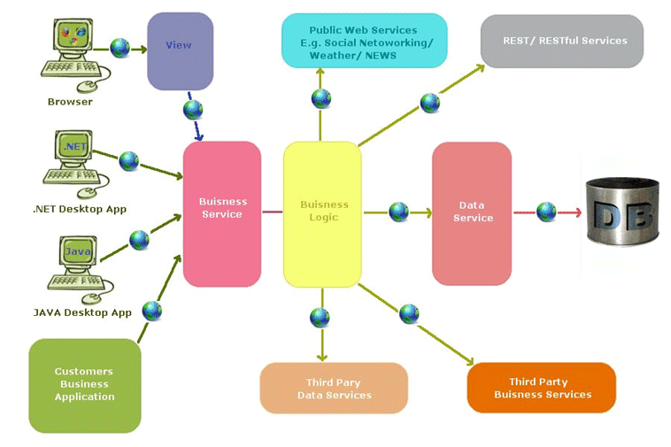
Web Application Architecture Service Oriented Architecture (SOA) Example
http://www.dimuthu.org/blog/2008/09/20/soa-way-of-writing-php/

Slide 19
Application Architectures
The model you choose depends on
the needs and requirements of the application
which are (ideally) driven by needs of the users
Our example will use the simple model
The simple model is fine for small applications
The simple model is good for gaining understanding
Just be aware that there are other solutions that provide advantages in scalability, modularity, portability, and interoperability.

Slide 20
PHP & MySQL
Simple approach:
Browser requests a PHP web page (e.g. index.php)
Web server receives request and passes to PHP engine
PHP engine parses the script
In the script, a database connection is opened
Queries are made against the database
Database system returns result to PHP engine
PHP engine finishes running the script
Query results are formatted (e.g. as HTML)
Web server returns response (e.g. HTML) back to the browser

Slide 21
Creating a DB Connection
We will be using the mysqli ("MySQL Improved") extension
Extensions extend the core PHP engine...
Exposes an API for managing database connections
Allows us to connect and perform SQL commands against a MySQL database
To do this we will introduce two new concepts:
We will use the object-oriented approach (rather than the procedural)
We will connect as a user that has rights only on the database we need to interact with

Slide 22
Object-Oriented PHP
PHP 5 provides full object-oriented development
For now we just need to understand how to interact with objects
In JavaScript, we use dot notation, e.g. window.alert("I just called the alert method of window);
Or perhaps window.location.assign(‘www.rpi.edu’) – maybe?? Like in the lab 10 we just finished?
In PHP, we use the arrow operator, e.g. // assuming we have mysqli database object called $db, // the following calls the query() method on that object: $result = $db->query($query);

Slide 23
Database Users
DBMSs allow us to establish users with explicit rights on specific databases in the system
In MySQL these users are held in the mysql.user table
We can manipulate the table or use the GRANT syntax to add users and set their rights (REVOKE is used to remove rights): GRANT all on iit.* to 'iit'@'localhost' identified by 'iit'; Grants all rights on a database named iit (and all its tables) to a user named iit coming only from localhost with password iitpw.
GRANT can be used to grant only SELECT, UPDATE, etc

Slide 24
Putting It Together
Let's explore the example code
Look at iitajax/index.php in your text editor
Visit http://localhost/iit/iitajax/
If you have not created the iit database user, the database connection will not work

Slide 25
Works Cited
MVC Architecture Model [Bitmap]. Retrieved November 26, 2010 from http://www.dimuthu.org/blog/2008/09/20/soa-way-of-writing-php/
SOA Model [Bitmap]. Retrieved November 26, 2010 from http://www.dimuthu.org/blog/2008/09/20/soa-way-of-writing-php/

